Slide 1
MGNT 5506G f Strategic Management for Competitive Advantage
Jingyu (Sissi) Li

Slide 2
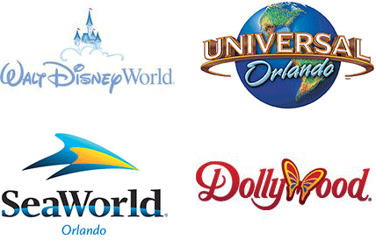

“I have been up against tough competition all my life. I wouldn't know how to get along without it.”
- Walt Disney

Slide 3
Objectives for Today
Define competitive rivalry and dynamics
Understand factors that influence likelihood of competition among firms
Exercise on the competitive dynamics

Slide 4



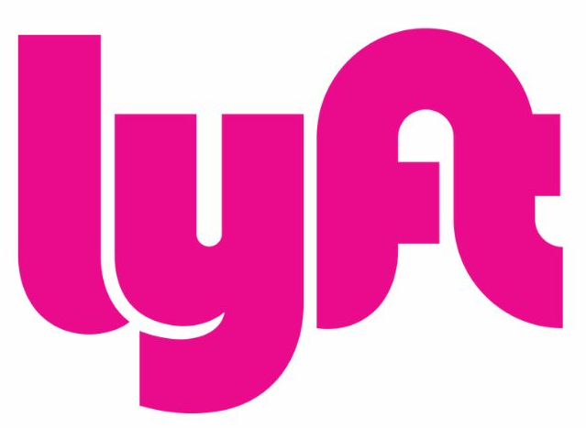
Opening Exercise: Rides-share apps
2009-2012
In March 2009, Uber was founded.
In March 2012, Kuai Di was founded.
In June 2012, Didi was founded.
In June 2012, Lyft was founded.

Slide 5
Opening Exercise: Rides-share apps
2013-2014
In November 2013, Uber entered China by offering premium services.
In January 2014, Didi announced a 5 RMB/order discount promotion.
Several days later, Kuai Di announced a similar promotion.
Several days later, Didi increased their promotion daily.
One day later, Kuai Di offered slightly higher discounts daily.
Another day later, DiDi randomized discounts per order.
In May 2014, Didi and Kuai Di stopped all promotions and discounts.
What are these firms competing for?
Who are their primary competitors at this stage?

Slide 6
Opening Exercise: Rides-share apps
2014-2016
In August 2014, Uber repositioned itself to offer affordable rides.
In February 2015, Didi and Kuai Di announced their merger as DDKD
In March 2015, Uber proposed investing in DDKD but got rejected.
In March 2015, Uber raised one billion USD to compete in China
In March 2015, DDKD
Raised 3 billion USD
Invested 1 billion USD in Lyft.
In August 2016, Uber China merged with DDKD
At this stage, what are these firms competing for?
Who are their primary competitors?

Slide 7
Competitive Action and Response
Industry Environment
Company ‘A’ Initiates Competitive Action
Industry Environment is Changed
Company ‘B’ Initiates Competitive Response
Industry Environment is Changed Again

Slide 8
Competitive Dynamics: Key Definitions
Competitors
Firms operating in the same market, offering similar products and targeting similar customers
Competitive Rivalry
Firm-to-firm competitive actions
Ongoing set of actions and responses occurring between competitors as they contend with each other for an advantageous market position
Also called interfirm rivalry or rivalry
Competitive Dynamics
Sum of all firm competitive actions
Total set of actions and responses of all firms competing within a market

Slide 9
Strategic Action vs Tactical Action
Strategic Action
Significant commitment of a specific and distinctive resource that is difficult to implement, and irreversible (Boeing’s midsized jet liner; Guess positioning to be more upscale)
Tactical Action
Commitment of less specific resources, taken to fine-tune a strategy, that is easier to implement, and reversible (e.g., pricing, advertising)
Exercise：Strategic Action or Tactical Action?
A "two movies for the price of one" campaign by Redbox
Use of product coupons by a local grocer
Entry into the European market by Home Depot
Fare increases by Southwest Airlines
Decision to introduce other brands by Aldi
Amazon acquired whole foods

Slide 10

Competitive Analysis Step 1: General Competitive Analysis
Purpose: Determine the extent to which firms are competitors
Components: Market commonality and resource similarity
Market Commonality (MC): Increases when firms compete in similar markets
The more overlapping markets (e.g., multimarket competition), the higher the MC
E.g., geographic, product, customer, etc. Burger King and KFC: High MC
Resource Similarity (RS): How comparable are competitor’s tangible and intangible resources in type and amount?
FedEx and UPS: High RS
McDonalds and Hyatt Café House: Low RS
Extent
of
Competitive Rivals
Market Commonality
Resource Similarity

Slide 11
Step 2: Study Drivers of Competitive Behavior
Competitive Tension
Awareness
Are managers aware of and do they understand key competitors?
The greater the scale of a given rival relative to a focal firm, the higher the competitive tension
Motivation
Does the competing firm have an “incentive” to take action or respond?
The greater the volume of a given rival’s attack on a focal firm’s market, the higher the competitive tension
Ability
Does the competing firm have the necessary resources to attack?
The greater a given rival’s ability to contest a focal firm, the higher the competitive tension

Slide 12
Step 3: Examine Likelihood of Attack & Response
Likelihood of Attack (LoA) Factors
Benefits, i.e., First-mover advantages
A firm that is likely to retaliate
Competitive tension
Likelihood of Response (LoR) Factors: When the competitors’ action
Benefits, i.e., might produce a stronger competitive advantage for the focal firm
Threats, i.e., damages the firm’s ability to create/maintain an advantage
The firm’s market position is less defensible
Competitive tension
Other factors to consider
Types of competitive action
Reputation of attacker
Market dependence

Slide 13
Exercise: Likelihood of Attack & Response
The greater A’s market commonality with B, the (less) likely A is to initiate an attack against B, all else being equal.
The greater A’s market commonality with B, the (more) likely A is to response an attack from B, all else being equal.
The greater A’s resource similarity with B, the (less) likely A is to initiate an attack against B, all else being equal.
The greater A’s resource similarity with B, the (more) likely A is to response an attack from B, all else being equal.
The greater the perceived competitive tension, the (greater) the volume of a focal firm’s attack on the rival’s market

Slide 14
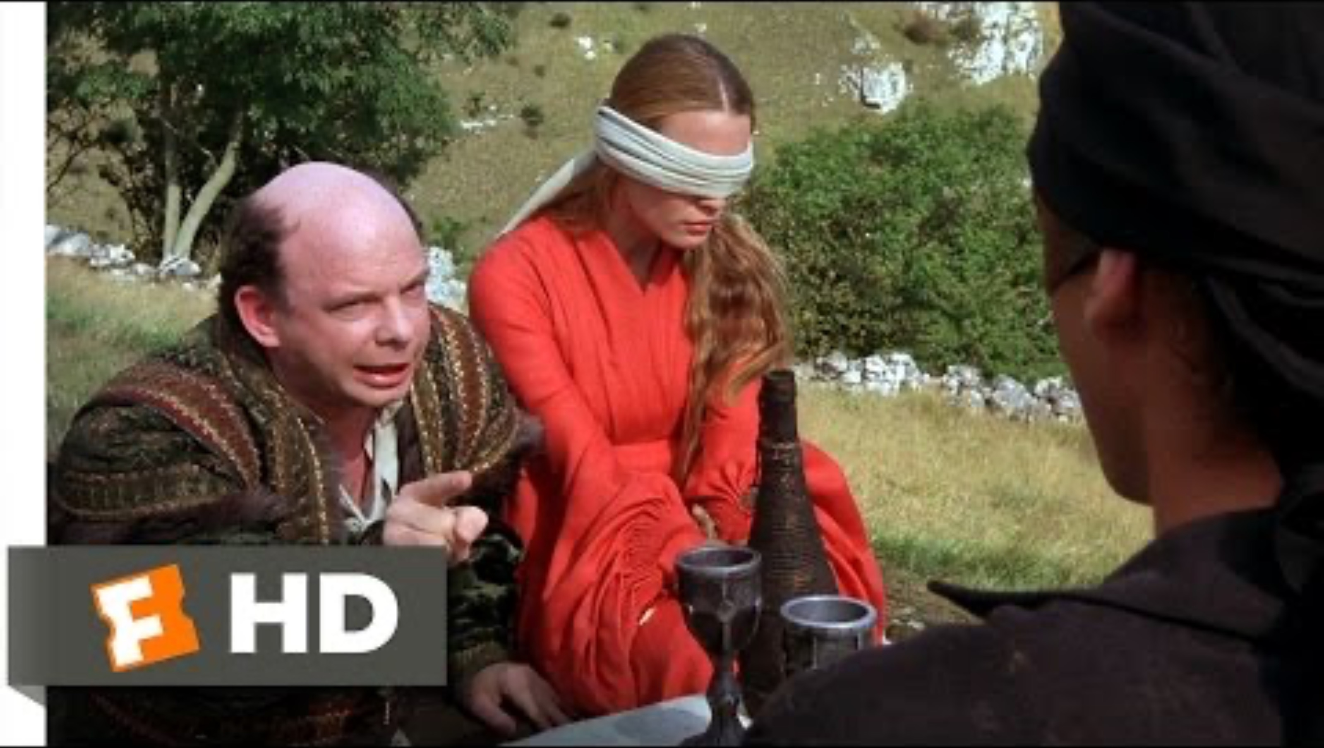

Slide 15
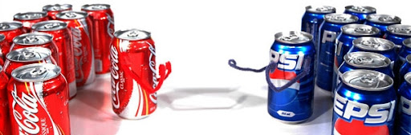
Cola-War: The Taste Test
Can you tell the differences between Coke and Pepsi?
Can you distinguish between the various varieties of Coke?
Let’s try it

Slide 16
Optional Class-Exercise: The Cola-War
You need to join either the Coke Group or the Pepsi Group
SID ending in an odd number → Coke group
SID ending in an even number → Pepsi group
You will participate in Three rounds
Each round, you need to discussion within your group to one selection as your group's strategic decision
Keep in mind that each solution will result in different competitive implications and subsequent responses from your competitor

Slide 17
Optional Class-Exercise: The Cola-War
Round 1: The "Pepsi Challenge" Crisis
Pepsi successfully launches the "Pepsi Challenge," showing consumers prefer Pepsi's sweeter taste in blind tests, significantly eroding Coca-Cola's market share.
Coca-Cola considers responding by adjusting its century-old formula.
Each group will have 5 minutes to discuss and decide on their strategic action.

Slide 18
Class-Exercise: The Cola-War
Pepsi Alternatives:
Aggressively expand "Pepsi Challenge" nationwide, significantly increasing advertising spending.
Launch a new formula to further emphasize taste superiority.
Publicly challenge Coca-Cola to televised taste-tests as a direct public-relations confrontation.
Temporarily pause the "Pepsi Challenge," shifting to broader brand advertising campaigns instead.
Coca-Cola Alternatives:
Aggressively launch "New Coke," completely replacing original Coca-Cola nationwide.
Introduce "New Coke" gradually alongside original Coca-Cola, testing consumer response first.
Ignore Pepsi’s challenge entirely, doubling down on traditional marketing emphasizing brand heritage.
Publicly reject the blind-test methodology used by Pepsi, emphasizing consumer loyalty over taste alone.

Slide 19
Optional Class-Exercise: The Cola-War
Round 2: Crisis Response Decision
Following Coca-Cola’s aggressive launch of "New Coke", consumers responded extremely negatively.
Sales plummeted, loyal customers openly protested, and Coca-Cola’s management faced a severe brand crisis.
Simultaneously, Pepsi experienced a significant market share gain,
However, Pepsi faced growing public criticism and fatigue over its aggressive, confrontational advertising strategy.
Each group will have 5 minutes to discuss and decide on their strategic action.

Slide 20
Optional Class-Exercise: The Cola-War
Coca-Cola decisions:
Immediately revert to original Coca-Cola formula, publicly acknowledging the error.
Keep New Coke, but simultaneously reintroduce Classic Coke quietly, without admitting mistakes publicly.
Persist aggressively with New Coke, investing heavily in marketing to reshape consumer preferences.
Publicly challenge Pepsi to a second round of blind tests, confident that long-term consumers will return.
Pepsi Decisions:
Moderate aggressive marketing, shifting toward a more balanced, brand-focused campaign to avoid consumer fatigue.
Increase aggressive marketing, openly mocking Coca-Cola’s quick reversal as indecisive and unreliable.
Introduce a "Pepsi Loyalty Guarantee" emphasizing consistency, contrasting Coca-Cola’s rapid product changes.
Launch a new healthier Pepsi product (Diet Pepsi Plus) to further differentiate clearly from Coca-Cola’s confusion.

Slide 21
Optional Class-Exercise: The Cola-War
Round 3: Cola Brand Homogeneity Crisis
Nowadays, consumer research confirms virtually no discernible taste difference between Coca-Cola and Pepsi.
Brand differentiation is challenging, creating fierce competition focused primarily on marketing and branding strategies.
Both Coca-Cola and Pepsi is considering new ways to differentiate.
Each group will have 5 minutes to discuss and decide on their strategic action.

Slide 22
Optional Class-Exercise: The Cola-War
Pepsi Decisions:
Launch "Better with Pepsi," focusing on exclusive restaurant and food delivery partnerships to promote Pepsi as the ideal meal pairing beverage.
Publicly challenge Coca-Cola to an online "taste & meal pairing" showdown, directly attacking Coca-Cola’s market image.
Introduce clearly differentiated new flavors (e.g., Citrus Pepsi) nationwide, explicitly contrasting Coca-Cola's limited innovation.
Temporarily pause marketing innovations, waiting to respond directly to Coca-Cola’s next move.
Coca-Cola Decisions:
Launch the global emotional branding campaign "Real Magic," emphasizing cultural connections, joy, and the unique emotional experience Coca-Cola offers.
Immediately counter Pepsi’s restaurant strategy by forming competitive exclusive partnerships with major global food chains (e.g., McDonald's, Subway).
Launch a direct advertising campaign dismissing Pepsi’s new food-pairing strategy as superficial marketing hype.
D. Challenge Pepsi’s differentiation by launching a public campaign claiming Coke pairs equally well or better with meals, directly confronting Pepsi’s claims.

Slide 23
Optional Class-Exercise: The Cola-War
Current situation: Cola Brand Homogeneity Crisis
Both companies find previous differentiation strategies yielded limited success
They must think of some other approaches to help gain competitive advantages
Take-home question: What else can both companies do?

Slide 24
Optional Class-Exercise: The Cola-War
Take Aways
Firms do not act in isolation; each strategic move directly affects competitors' actions and responses, shaping market dynamics
Understanding competitor reactions is essential when making decisions.
Aggressive moves provoke direct competitive responses.
Successful companies adapt quickly when their initial strategies do not yield expected results.
Companies must balance commitment to chosen strategies with the flexibility to adjust based on competitor behavior.
When products are similar, differentiation through branding, emotional appeal, or niche market strategies becomes vital.

